Slide 1

Regression Analysis

Slide 2
Objectives
Fundamentals of regression analysis
Perform a T test, an ANOVA
Find the Pearson correlation, and perform regression analysis.
Regression Analysis

Slide 3
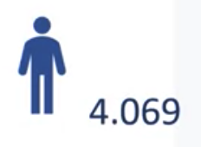
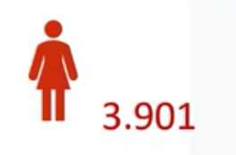

Regression in place of T -Test
We will begin with a question, and the question is, is there a statistically significant difference in teaching evaluation scores for men and women?
When we compute, the averages while using the teaching evaluation data set, we find that the teaching evaluation score for women is around 3.9, and for men, it's around 4.06.
The question is, is this difference, even though it's small, statistically significant
Regression Analysis

Slide 4
Regression in place of T -Test
We can run at t-test using Python and compute the statistical significance for the t-test.
Here, our conclusion is that the teaching evaluation scores difference between men and women, is statistically significant
Regression Analysis

Slide 5
Regression in place of T -Test
What if we were to do the same thing with the regression model?
We will do the linear regression in Python. We will be using the statsmodel library.
  We will create a list for the independent variable, that is the female variable, which has been turned to a binary variable, where 1 equals female and 0 is male.
  We will also create a list for the dependent variable, teaching evaluation score.
  We will manually add the constant beta zero, then we will fit and make predictions, and print out the model summary
Regression Analysis

Slide 6
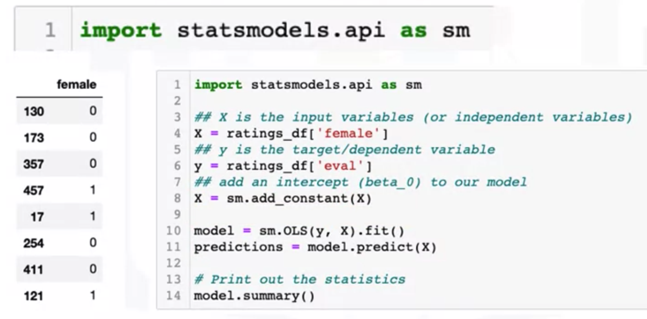
Regression in place of T -Test
Regression Analysis

Slide 7
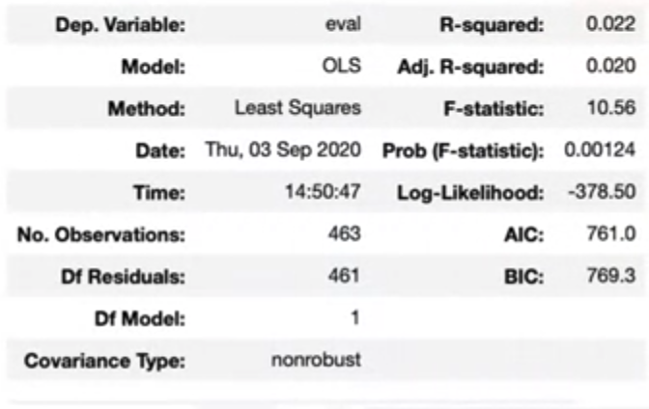
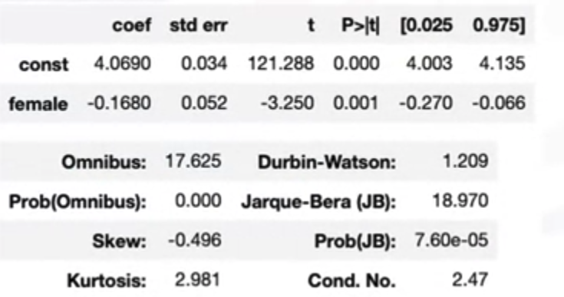
Regression in place of T -Test
The model summary will print out a table like this
Regression Analysis

Slide 8
Regression in place of T -Test
But we are only interested in this part of this table for the t-test, it prints out the coefficient error, t statistics and pin value.
We can see the t statistics for the female variable is negative 3.25, and the P value is less than 0.05.
That means that there is a statistical difference in mean values for male and female instructors.
The coefficient means that you are most likely to lose about 0.17 marks for being a female.
Regression Analysis

Slide 9
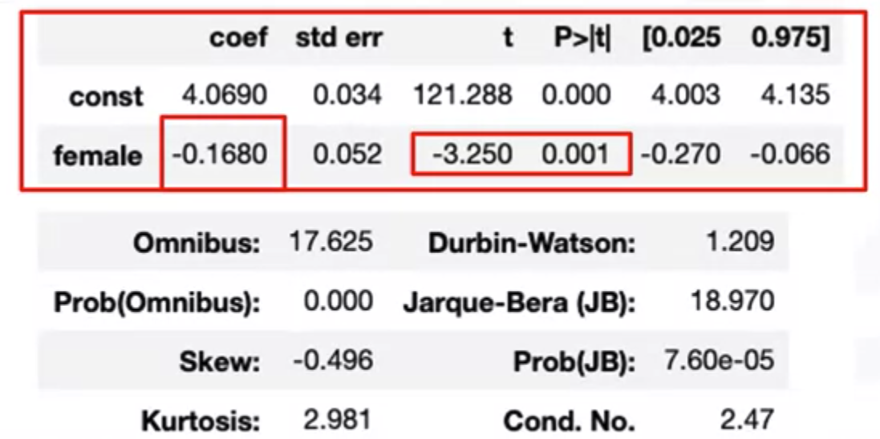
Regression in place of T -Test
Regression Analysis

Slide 10
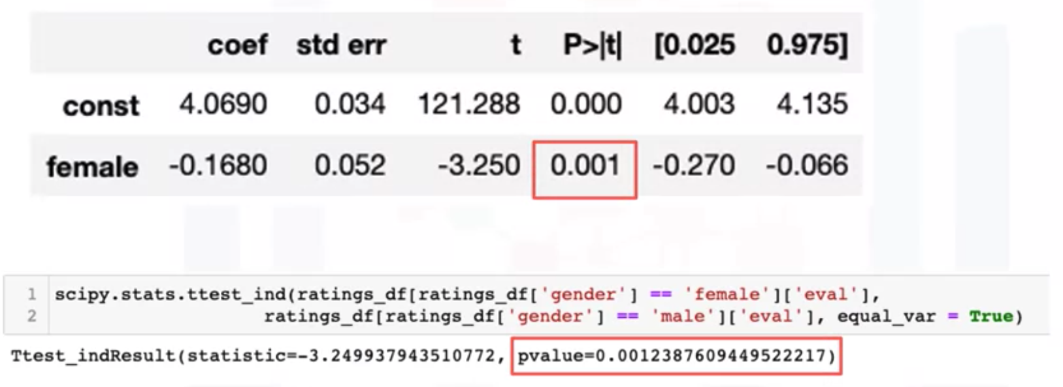
Regression in place of T -Test
We can see that the results from using a regression model, and the conclusion is identical, if we run a t-test
Regression Analysis

Slide 11
Regression in place of ANOVA
When we are comparing the difference in means or when we are comparing the averages between groups that are more than two, we will use ANOVA or analysis of variance.
We know that if there are only two groups, we can use the t-test, but when we are comparing averages for more than two groups, we use analysis of variance.
Regression Analysis

Slide 12
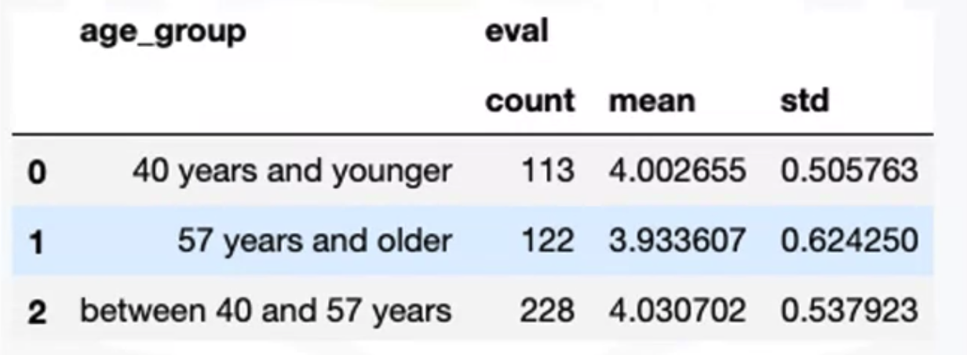
Regression in place of ANOVA
Working with our teaching evaluation dataset, we took the teaching evaluation scores and then we wanted to see what would happen if we took the instructors and divide them into three groups:
  40 years and younger
  between 40 and 57 years of age
  57 years or older.
Regression Analysis

Slide 13
Regression in place of ANOVA
We computed the average value for teaching evaluation score for the three groups.
We wanted to determine if the three mean values were statistically different
Regression Analysis

Slide 14
Regression in place of ANOVA
We ran the analysis of variance test, which uses F-distribution. The p-value is less than 0.05.
We reject the null hypothesis that averages of the group are equal and concluded that the differences are statistically significant.
Regression Analysis

Slide 15
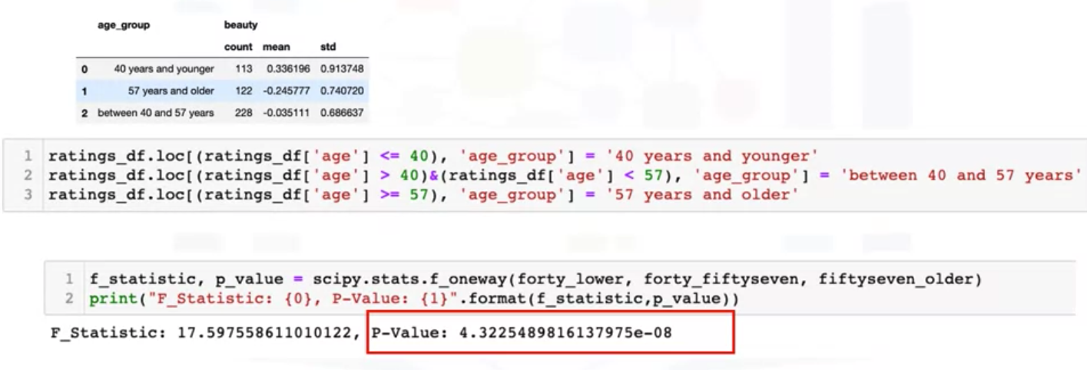
Regression in place of ANOVA
Regression Analysis

Slide 16
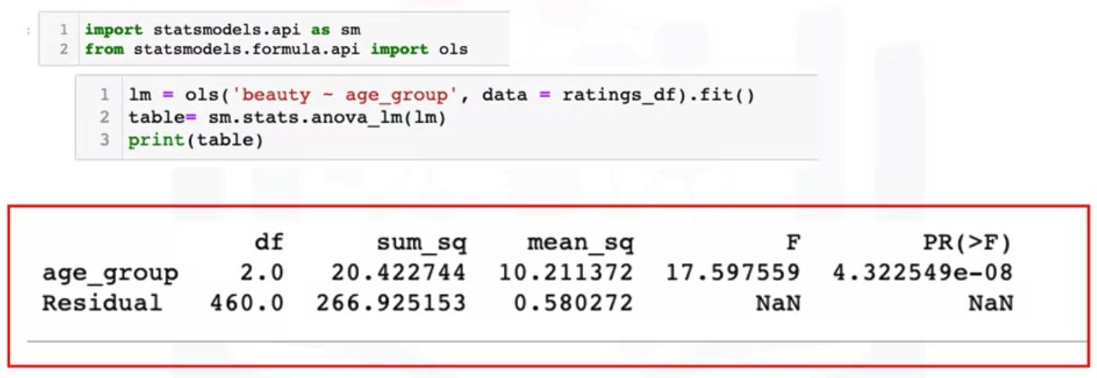
Regression in place of ANOVA
Regression for ANOVA
Regression Analysis

Slide 17
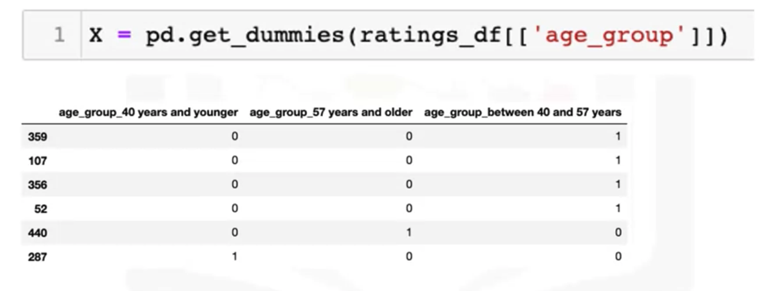
Regression in place of ANOVA
You can also turn the age group values into dummy values and run it like you run the regression for t-test
Regression Analysis

Slide 18
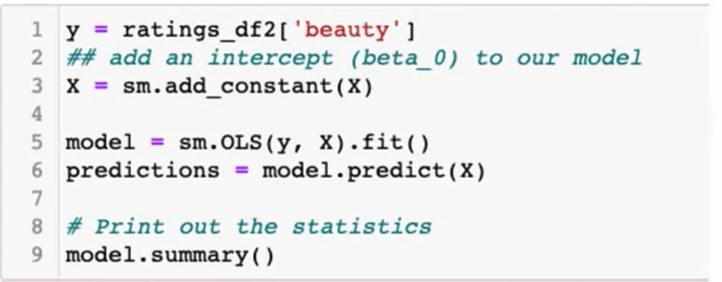
Regression in place of ANOVA
Run the same as you did for the t-test by fitting the variables into an OLS function, predict, and print out the model summary. We will get results like this.
Regression Analysis

Slide 19
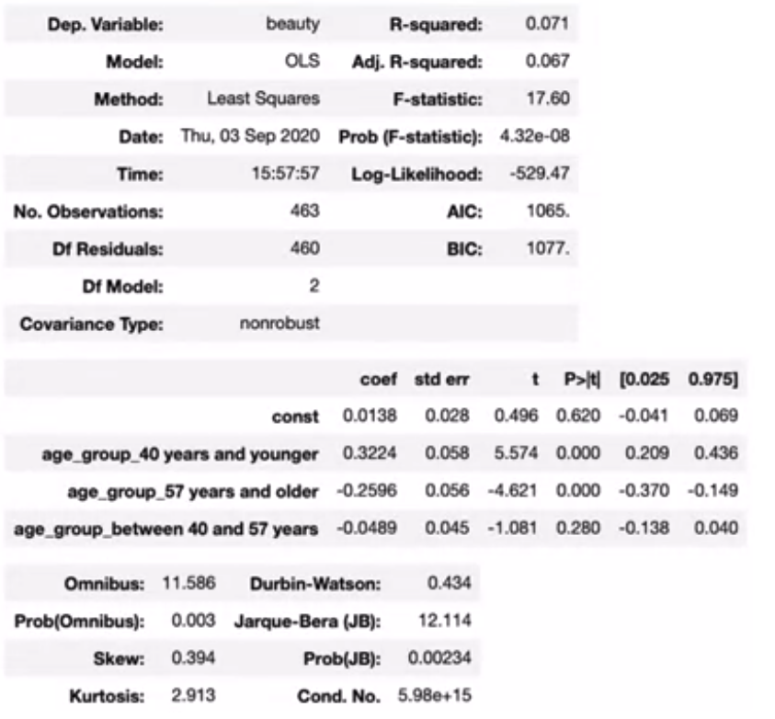
Regression in place of ANOVA
Regression Analysis

Slide 20
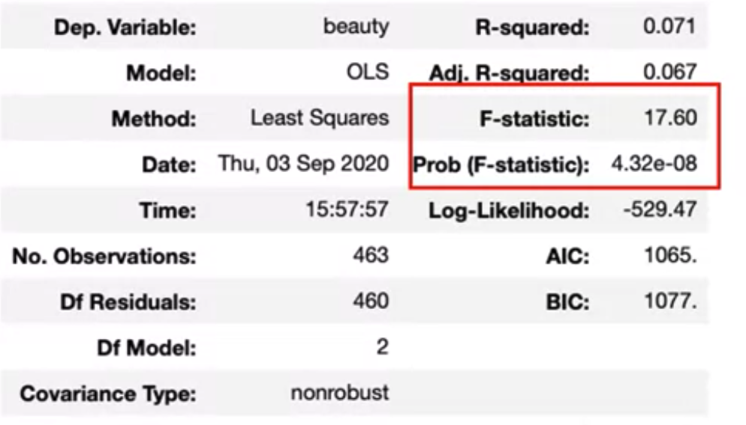
Regression in place of ANOVA
Regression Analysis

Slide 21
Regression in place of Correlation
Correlations: these some type of variables
  Categorical variables
  Continuous variables
We can plot two continuous variables in a scatter plot.
The teaching evaluation scores are on the Y axis and the normalized beauty scores are on the X axis.
You could sort of see a relationship between the two variables. It's an upward sloping type of a relationship.
We see that as the beauty score increases, so does the teaching evaluation score.
Regression Analysis

Slide 22
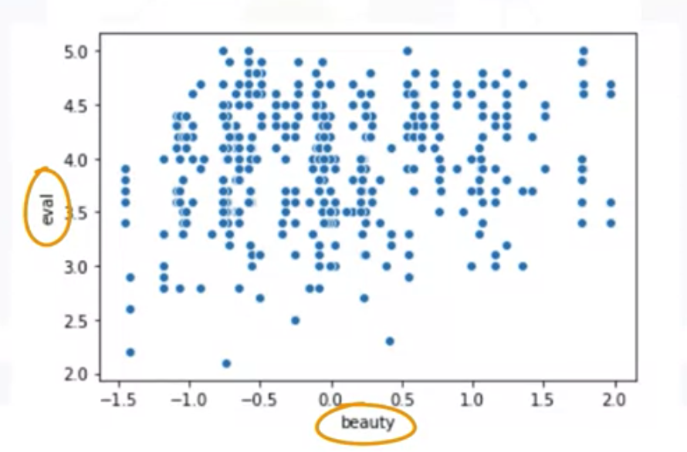
Regression in place of Correlation
Regression Analysis

Slide 23
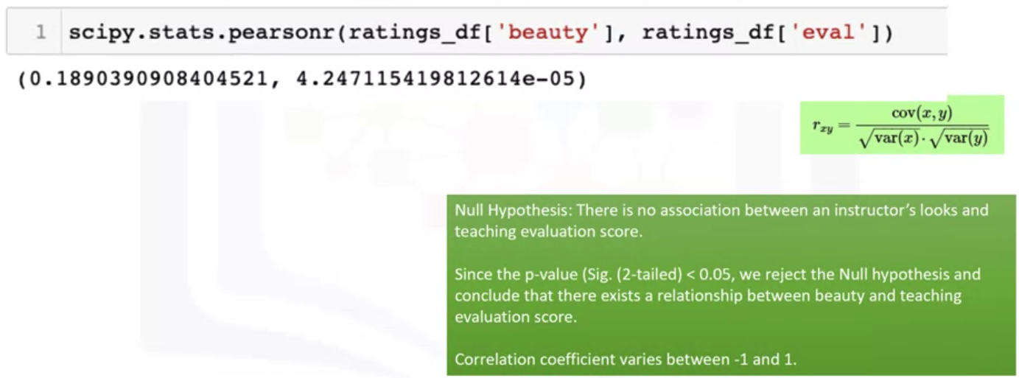
Regression in place of Correlation
We used the Pearson correlation test to determine the relationship and its significance level
Regression Analysis

Slide 24
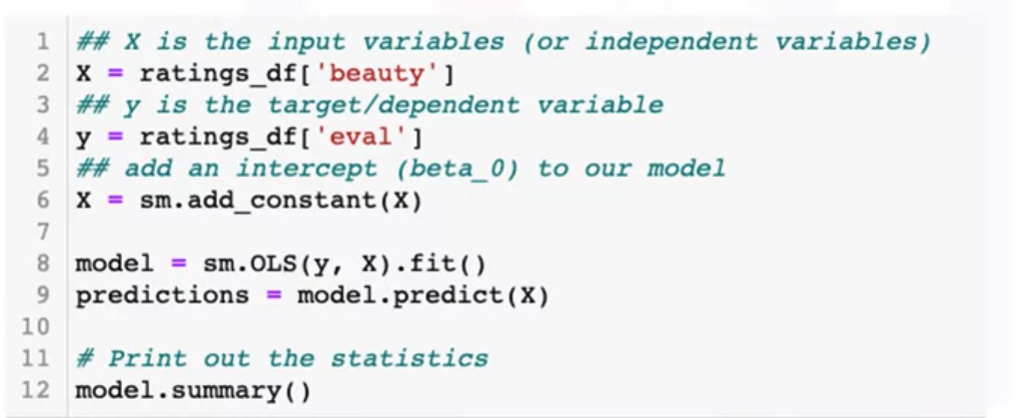
Regression in place of Correlation
We did with the T test and the F test, we will fit a linear model for both the beauty, an evaluation score, values and print out the models summary.
Regression Analysis

Slide 25
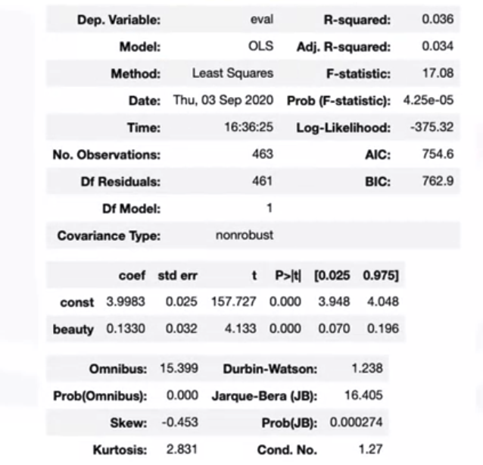
Regression in place of Correlation
Regression Analysis

Slide 26
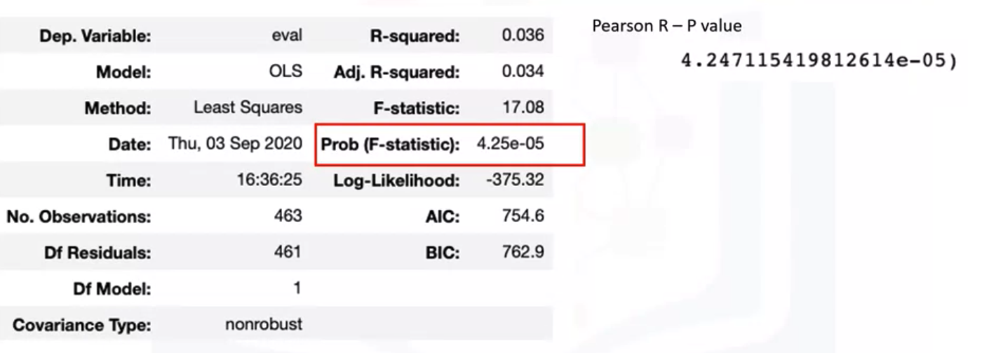
Regression in place of Correlation
Taking a closer look, it prints out a P value of 4.25 * 10 raised to power negative 5, which is less than 0.05..
That is very similar to when we run the Pearson r function.
Regression Analysis

Slide 27
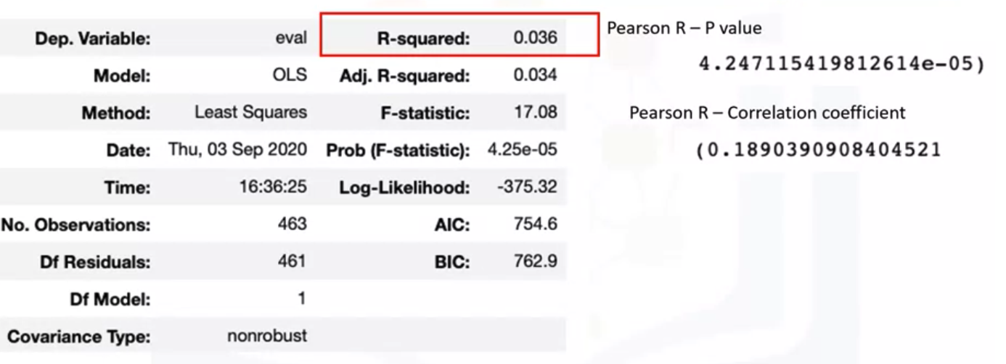
Regression in place of Correlation
It will also give us the R-squared- value, that is, if we took square root 0.036.
It will give us 0.189 which is the some value as the correlation coefficient from computing the Pearson R.
Regression Analysis

Slide 28
Summary
Understand fundamentals of regression analysis
Perform a T test, an ANOVA
Find the Pearson correlation, and perform regression analysis.
Regression Analysis

Slide 29
Q & A
Regression Analysis

